Slide 1

About me
Presented by- priyanshu joshi
10 D

Slide 2
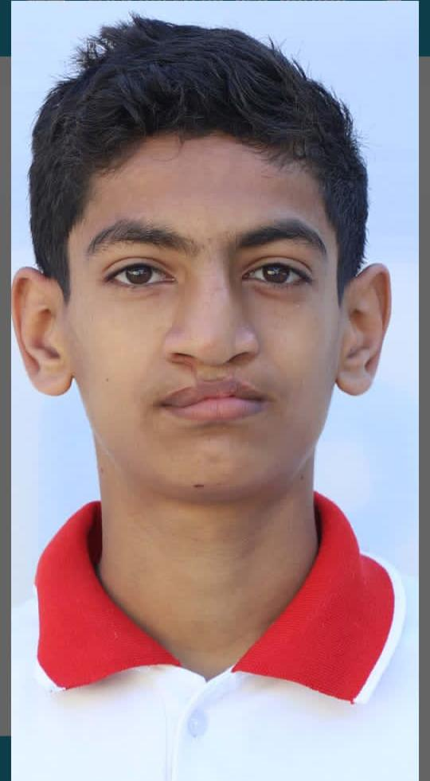
My introduction..
My name is priyanshu joshi
I am the student of class 10 D of Evergreen Senior Secondary School
My father name is Mr Tara Dutt Joshi
My mother name is Mrs Tulsi Joshi
My Birth date is 6 February 2008
This is some introduction about me....

Slide 3
Introduction with my family
Family is not an important thing, It’s everything
My family is short family
In my family there are 4 members including me
They are my father, my mother, my younger brother and me
The family is one of natures masterpieces

Slide 4
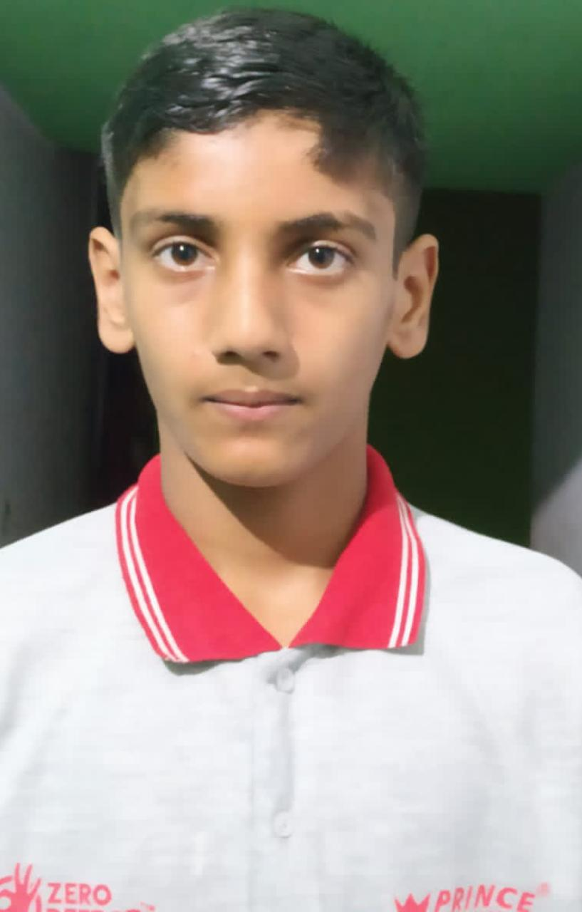
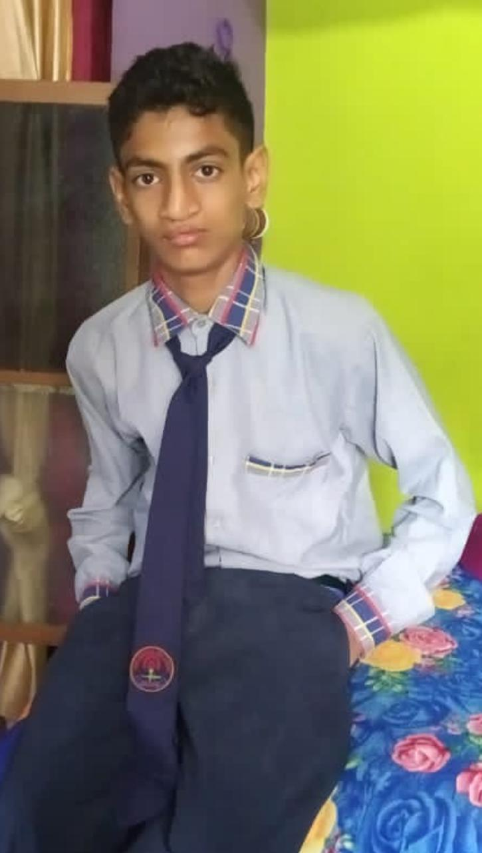
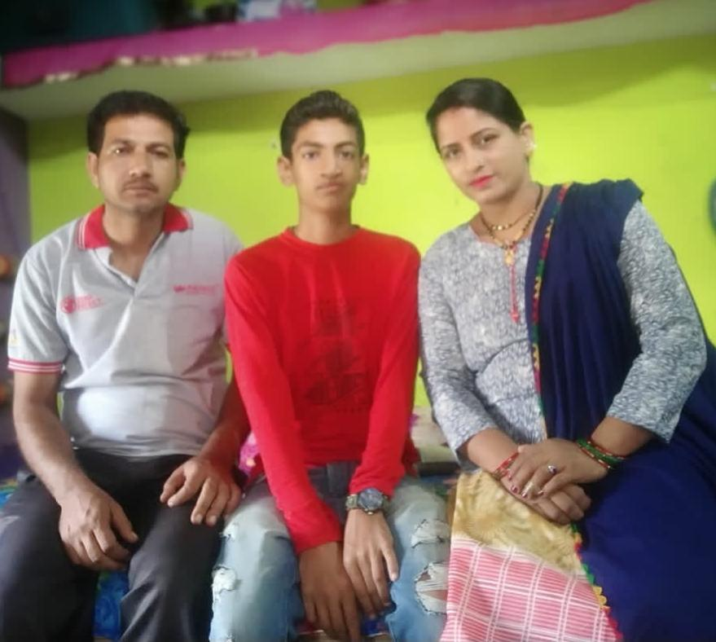
My Family

Slide 5
My hobbies....
My hobbies are............
I love to play cricket
I love to play oudoor games which are beneficial to human body
I like the way to be passionate
And i want simplicity in my life ....
My best hobby is to do what my mind is saying to do i didn’t want to do that people wants.....

Slide 6
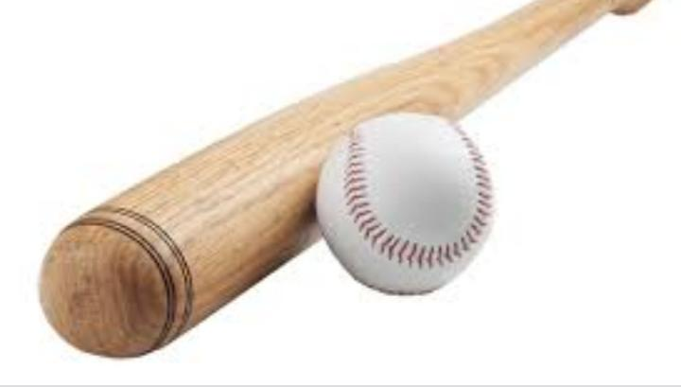

Some images of my hobby

Slide 7
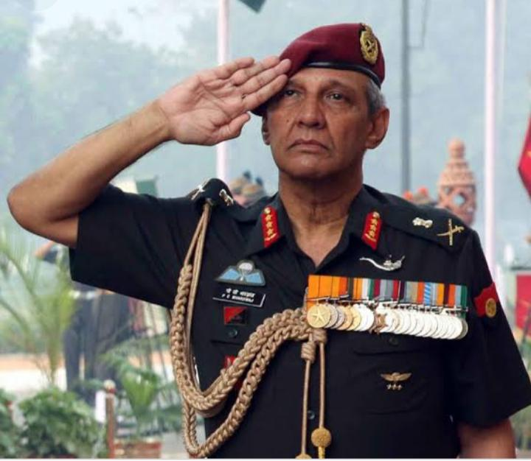
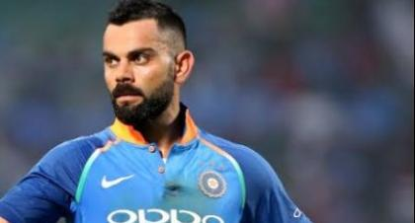
What I want to become?
I want to become an army officer or a cricketer
To become, you must first believe......

Slide 8
Recaptulation
Myself priyanshu joshi as a student of class 10 from evergreen senior secondary school I have made this file about my introduction......
I have written all the points regarding me that are necessary
That all about me .................

